Slide 1
Evaluating ROVIO and OKVIS – Two Visual-Inertial Odometry Implementations
Julian Surber
Semester Thesis
Supervised by Margarita Chli & Lucas Pinto Teixeira

Slide 2
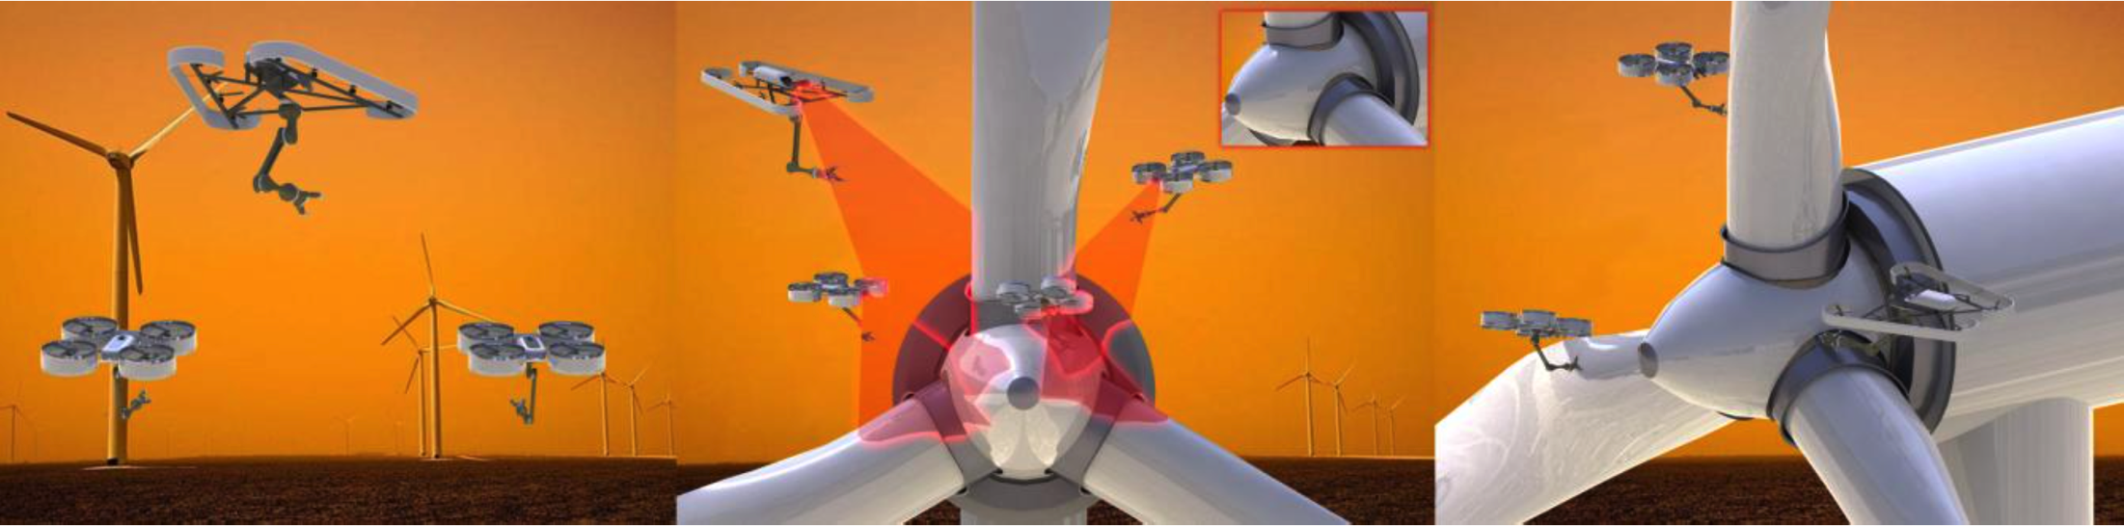
Intro
One key challenge: Single Robot Localization
Global and Local
Visual-Inertial Odometry
Complementary Properties
Lightweight
Cheap
Passive, onboard sensors

Slide 3
Rovio and Okvis
Time-Synchronization
Outlook
Comparing Rovio and Okvis: Working principles, Differences and Accuracy
Visual-Inertial Odometry on non-time-synchronized Hardware?
Outlook

Slide 4
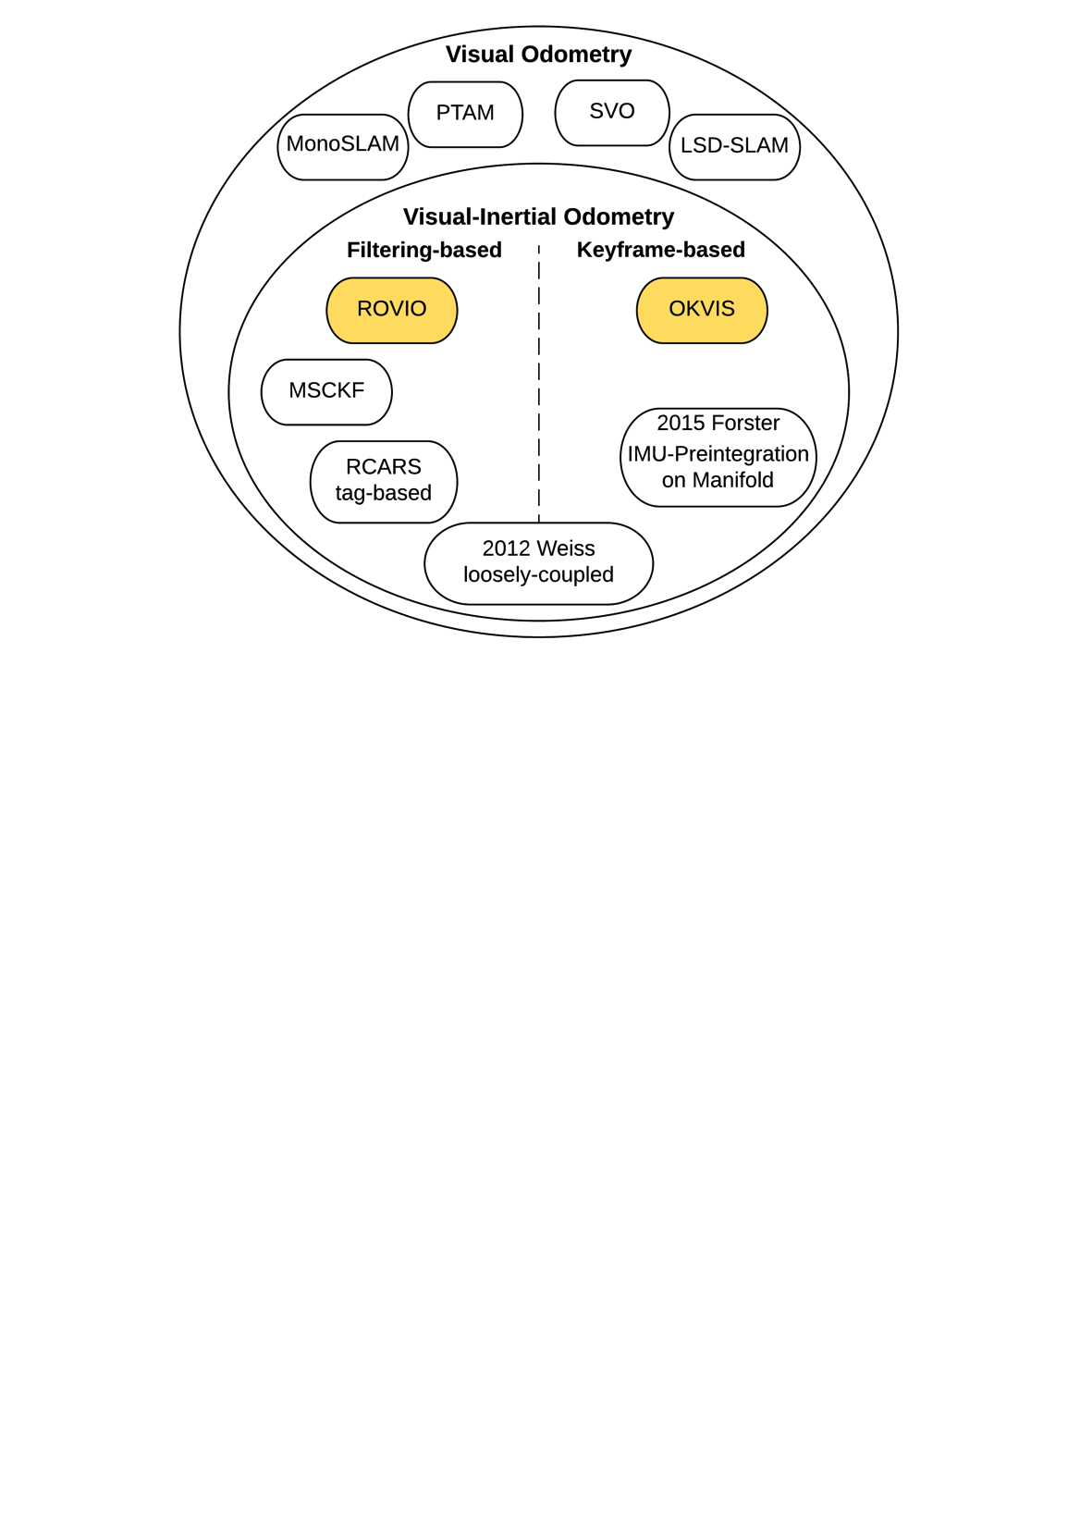
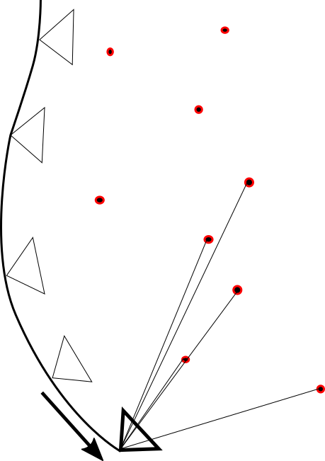
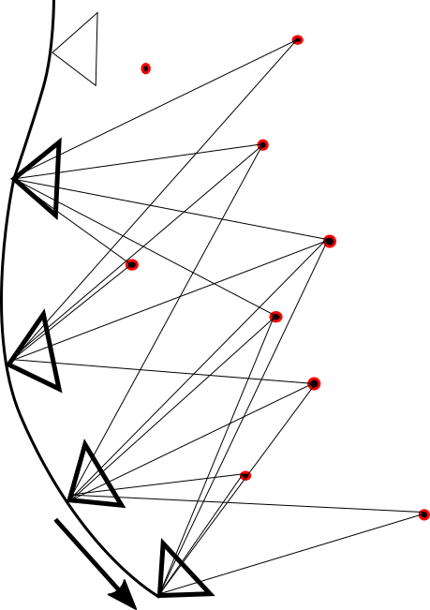
Overview
Rovio and Okvis
Time-Synchronization
Outlook

Slide 5
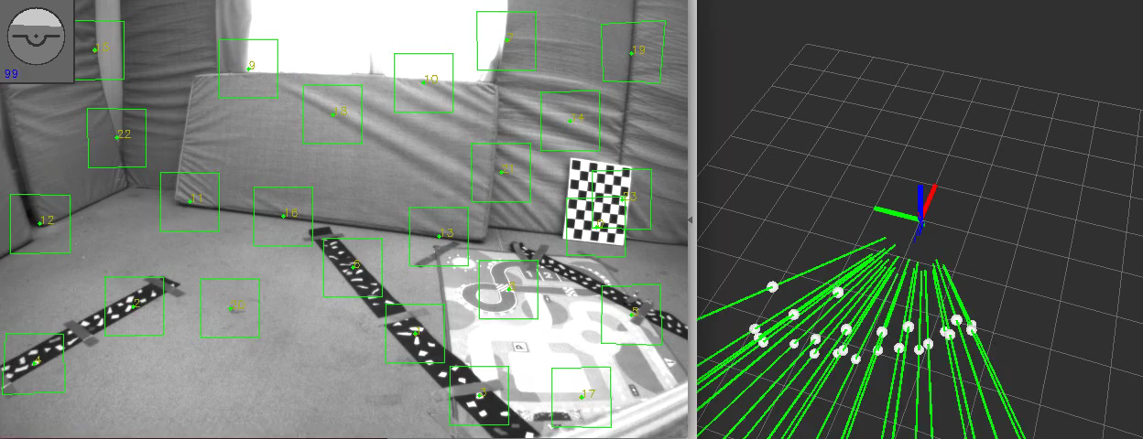
ROVIO – Robust Visual Inertial Odometry Using a Direct EKF-Based Approach
Rovio and Okvis
Time-Synchronization
Outlook
Fast Corner Detector / Multilevel Direct Intensity Patch Features
Position, Velocity, Attitude, IMU Biases, IMU-Camera Extrinsics, Features (Bearing Vector and Distance to Frame)

Slide 6
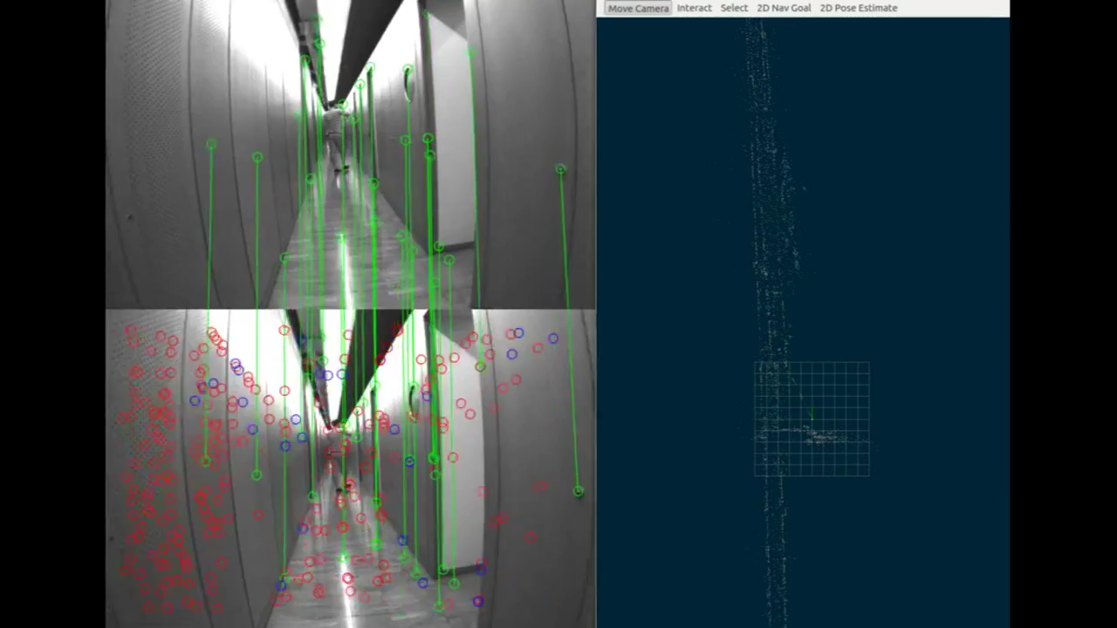
OKVIS – Optimal Keyframe-Based VI SLAM
Rovio and Okvis
Time-Synchronization
Outlook
Harris Corner Detector / BRISK Features
Nonlinear Optimization of Keyframe Poses, current Frame Poses, Velocity Terms, IMU Biases and Landmark Positions

Slide 7
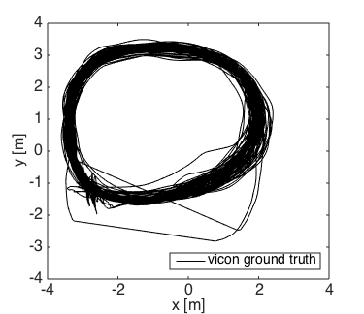
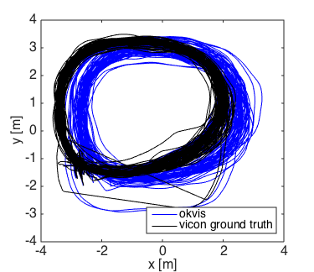
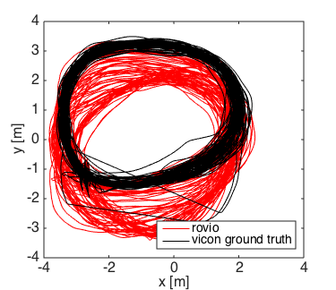
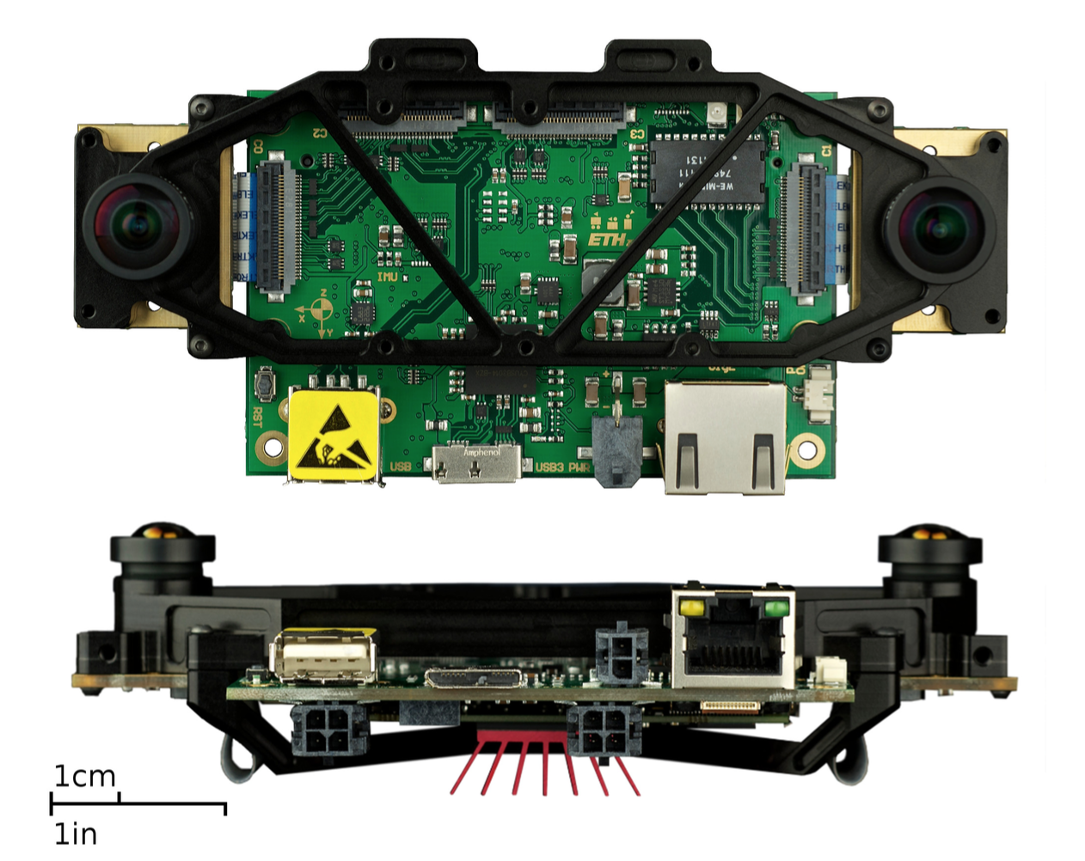
Comparison
Rovio and Okvis
Time-Synchronization
Outlook
VI Sensor
Distance 1200 m, handheld, 100 Loops
Dynamics: 2.5 m/s, 3 rad/s

Slide 8
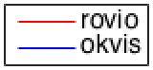
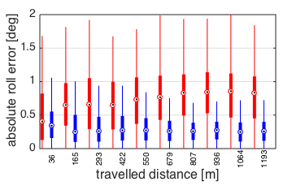
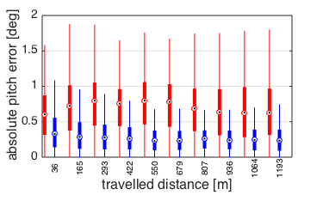
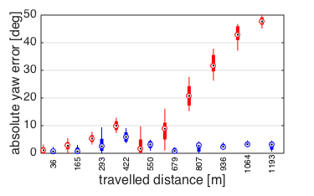
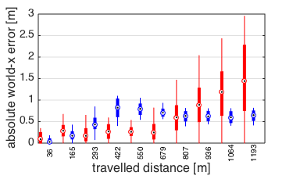
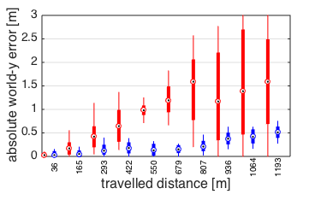
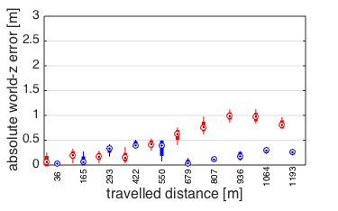
Global Accuracy – separated axes
Rovio and Okvis
Time-Synchronization
Outlook

Slide 9
Global Accuracy
Rovio and Okvis
Time-Synchronization
Outlook
Yaw Drift of Rovio 10 times higher over 1000 m
World-z Drift of Rovio 3 times higher over 1000 m

Slide 10
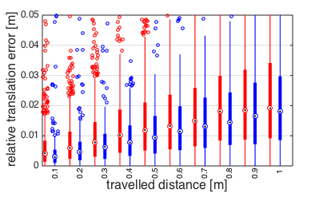
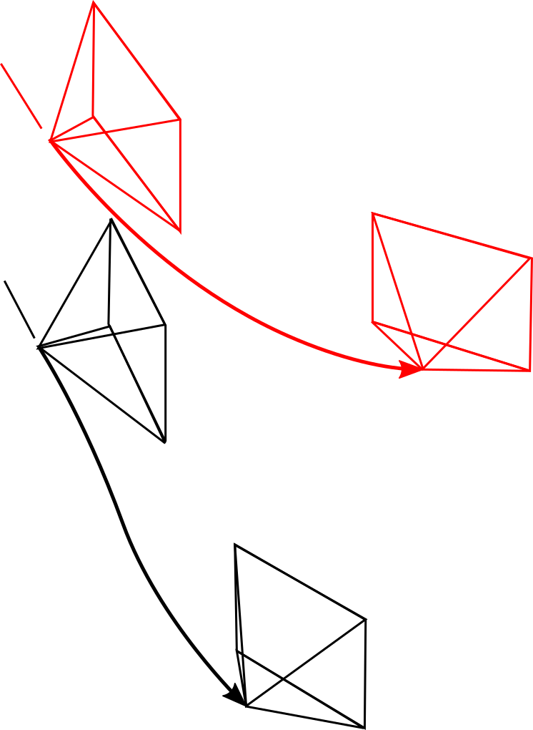
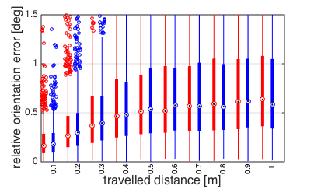
Local Accuracy
Rovio and Okvis
Time-Synchronization
Outlook

Slide 11
Results
Rovio and Okvis
Time-Synchronization
Outlook
 | Rovio | Okvis
Global Yaw Error | 45 ° / 1000 m | 4 ° / 1000 m
Global world-z Error | 1 m / 1000 m | 30 cm / 1000 m
Local Translation Error | 2 cm / 1 m | 2 cm / 1 m
Local Orientation Error | 0.6 ° / 1 m | 0.6 ° / 1 m
Processing Time / Frame | 10 ms | Unknown, higher

Slide 12
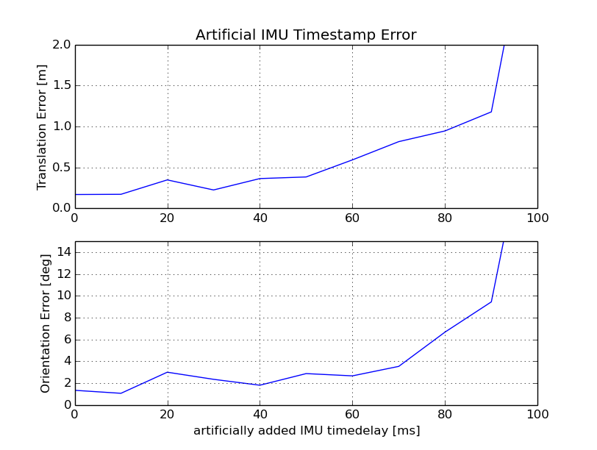
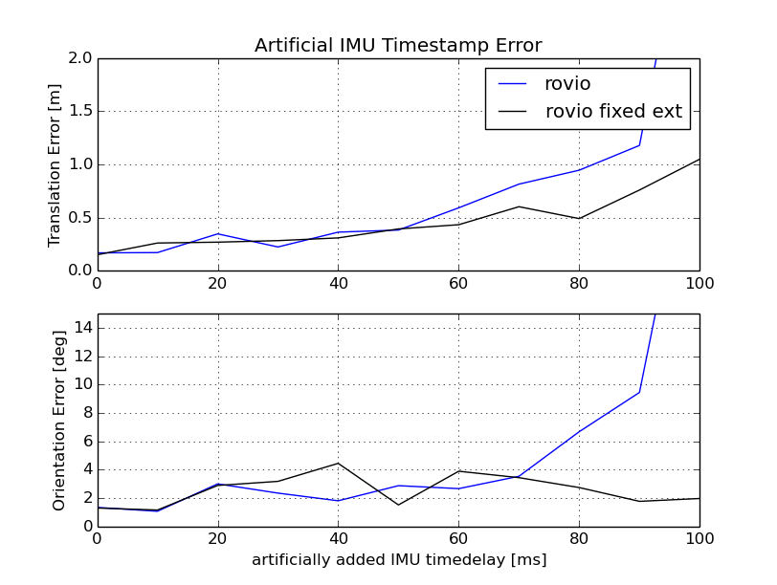
Towards non-timesynchronized Hardware 1) Analysis with artificial timedelay
Rovio and Okvis
Time-Synchronization
Outlook

Slide 13
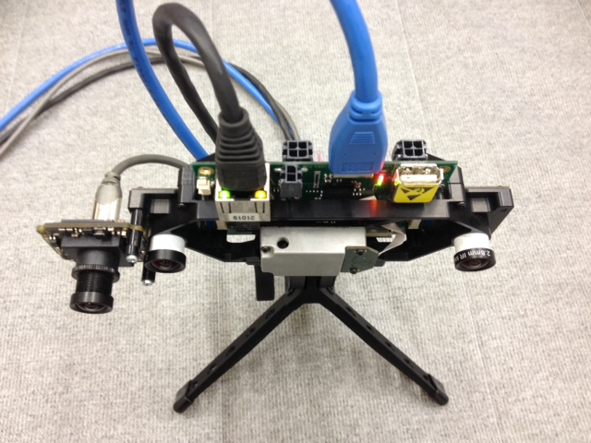
Towards non-timesynchronized Hardware Real Test
Rovio and Okvis
Time-Synchronization
Outlook
VI Sensor
Bluefox 2.0
Indoor, handheld, 60 m, 3 loops
Slow and Fast Dataset

Slide 14
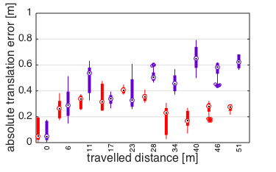
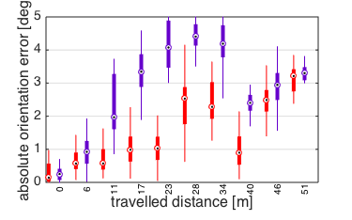
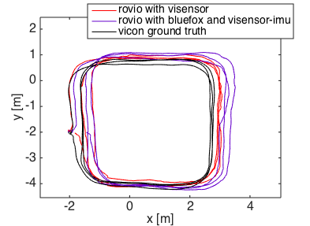
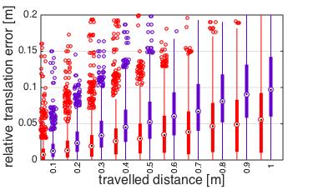
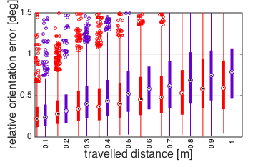
Slow Dataset
Rovio and Okvis
Time-Synchronization
Outlook
Dynamics: 1.5 m/s, 1 rad/s
Non-timesynced Hardware is able to track
Visensor performs better

Slide 15
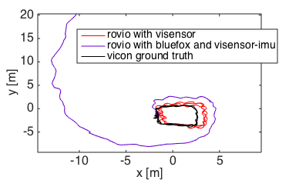
Fast dataset
Rovio and Okvis
Time-Synchronization
Outlook
Fast, shaky motions
Dynamics: ?, ?
Non-timesynced Hardware diverging

Slide 16
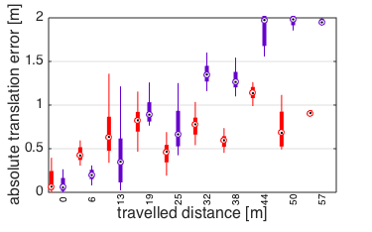
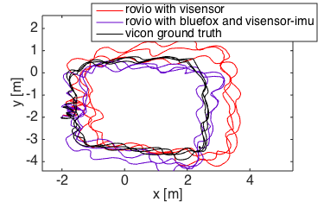
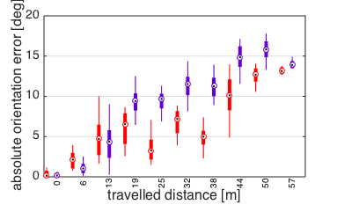
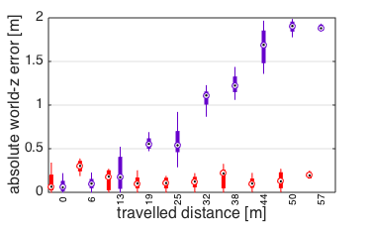
Fast dataset – Fixed Extrinsics
Rovio and Okvis
Time-Synchronization
Outlook
Fixing the Extrinsics on non-timesynced Hardware increases Rovio performance

Slide 17
Outlook
Rovio and Okvis
Time-Synchronization
Outlook
Outlook
Rovio: Include additional Sensorinformation (GPS, Mag)
Rovio: Combine with „Backend“ performing a Global Optimization
Make Okvis running and evaluate
Run Rovio on Embedded system with lower-quality IMU and non-timesynchronized Hardware

Slide 18
Thank you !

Slide 19
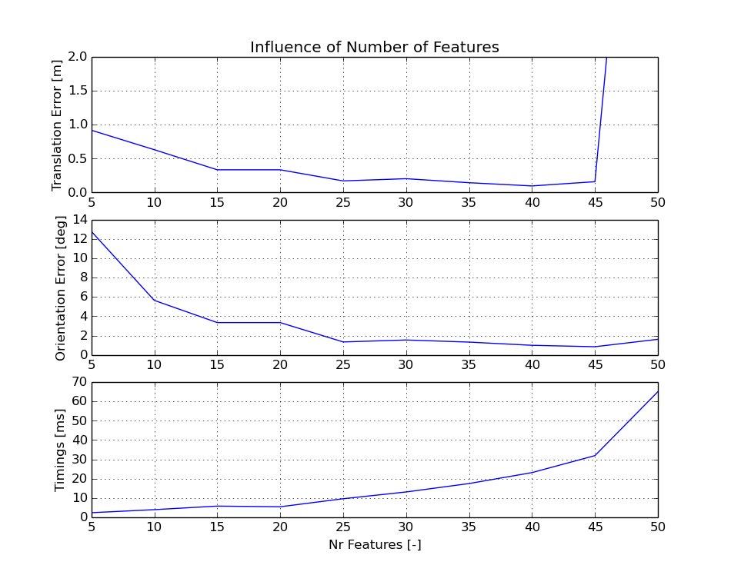
Features / Computational Complexity

Slide 20
Ev features

Slide 21
Long Trajectory

Slide 22
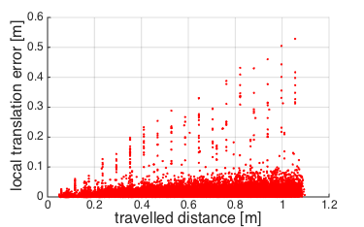
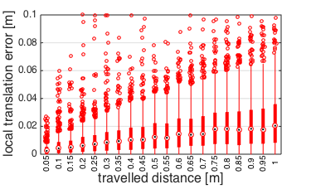
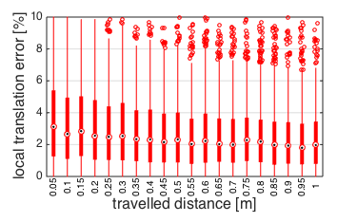
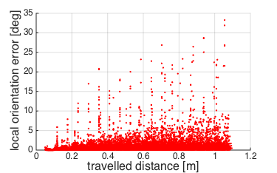
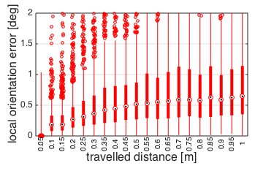
LTE = 2 cm / 1 m (2 %)
LOE = 0.6° / 1 m

Slide 23
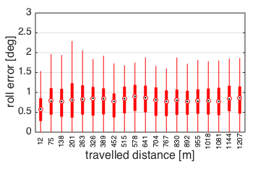
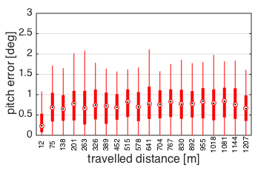
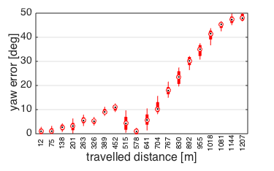
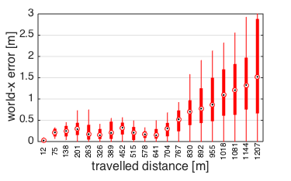
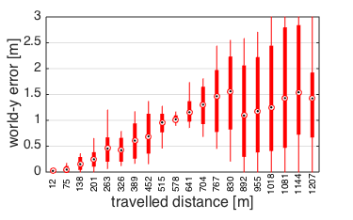
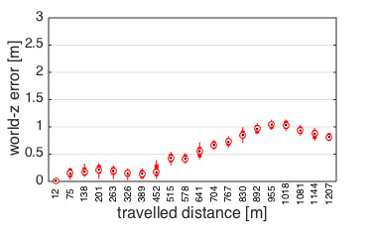
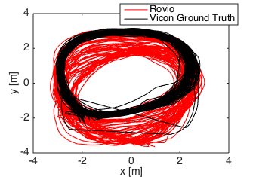
GOE_Yaw = 45 deg / 1000 m
GTE_Z = 1 m / 1000 m (0.1 %)

Slide 24
Long Trajectory: Summary (create Table!)
Local Accuracy:
LTE = 2 cm / 1 m (2 %)
LOE = 0.6° / 1 m
Global Accuracy
roll and pitch errors bounded
yaw error = 45 deg / 1000 m
x and y errors are driven by yaw
z error = 1 m / 1000 m (0.1 %)
Computational Complexity
Average Processing Time per Image = 10 ms

Slide 25
Results
Yaw-Drift of Rovio 10 Times higher than Okvis
Global Translation Error 2 Times higher than Okvis
World-z Error ? Times higher than Okvis
Locally Rovio and Okvis similar (?)

Slide 26
Short Trajectory

Slide 27
Evaluation Sheme
Local Accuracy
Local Translation Error
Local Orientation Error
Global Accuracy
Absolute Translation Error
Absolute Orientation Error
World-Z Error
Yaw Error
Computational Complexity
Processing Time for a new Frame

Slide 29
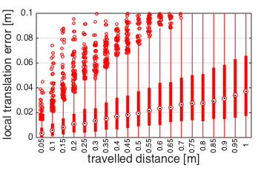
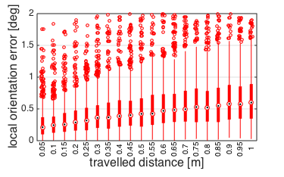
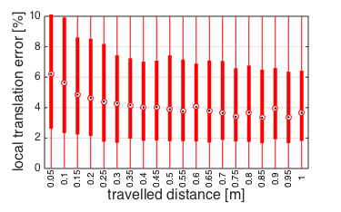
LTE = 4 cm / 1 m (4 %) LOE = 0.6° / 1 m

Slide 30
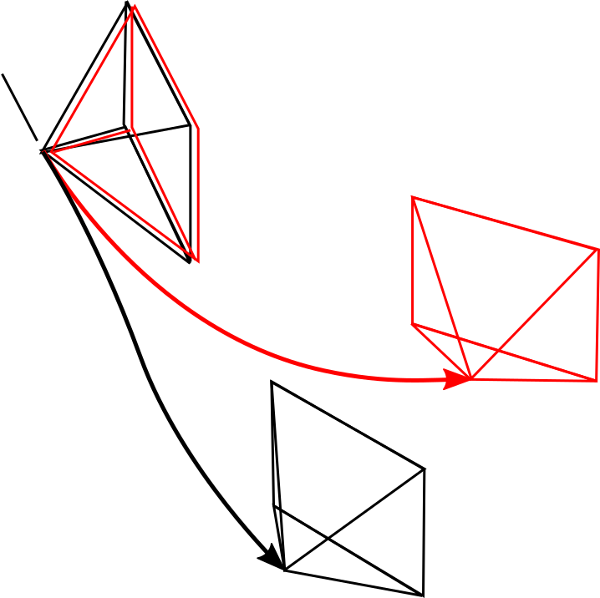

Slide 31







GOE_Yaw = 1 deg / 50 m
GTE_Z = 5 cm / 50 m (0.1 %)

Slide 32
ROVIO – Robust Visual Inertial Odometry Using a Direct EKF-Based Approach
State Propagation with IMU (200 Hz)
Position, Velocity, Attitude, IMU Biases, IMU-Camera Extrinsics, Features (Bearing Vector and Distance to Frame)
Update with Cameraframes (20 Hz)
Feature Detection with Fast Corner Detector
Multilevel patch Features
Direct Intensity Error
„Small“ number of Features

Slide 33
OKVIS – Optimal Keyframe-Based Visual Inertial SLAM
Nonlinear optimization
Position, Velocity, Attitude, IMU Biases, Landmarks
Propagation with IMU
Multiscale Harris corner detector
Brisk descriptor aligned with gravity
Marginalization: Keep only several Keyframes and Landmarks
„Large“ number of Features

Slide 34
Short Trajectory: Summary (create Table!)
Local Accuracy:
LTE = 4 cm / 1 m (4 %)
LOE = 0.6° / 1 m
Global Accuracy
roll and pitch errors bounded
yaw error = 1 deg / 50 m
x and y errors are driven by yaw
z error = 5 cm / 50 m (0.1 %)
Computational Complexity
Average Processing Time per Image = 10 ms

Slide 35



Slow Dataset – Global Accuracy
Visensor performs better
New Hardware is able to track

Slide 36


Yaw Drift
Translational Drift

Slide 38
Global Error
Thanks to gravity: Roll and Pitch Errors bounded (small)
Yaw Drift
World-X and World-Y Errors driven by Yaw Error
World-Z Drift
Local Errors cancel out → Global Error smaller than integrated local errors

Slide 40




Robot
B
C
I
J

